Slide 1
Elementary Math Models: A hybrid alternative to standard general education math courses
A workshop presented at the Allegheny Section MAA spring meeting, 3/28/2025
Dan Kalman
Materials at emm2e.info/workshopA

Slide 2
Outline
Motivation: standard course drawbacks
Goals and Curricular Design Principles
The Mathematical Story
Pedagogy
Classroom Experience

Slide 3
Standard Courses
College Algebra
  Needs no description here?
Liberal Arts Math
  EG Heart of Mathematics
  Emphasize positive aspects of math, beyond arithmetic and algebraic technique
Quantitative Literacy
  Math skills applicable to everyday life
  Math methods for informed participation in society
Next: My view of pros and cons

Slide 4
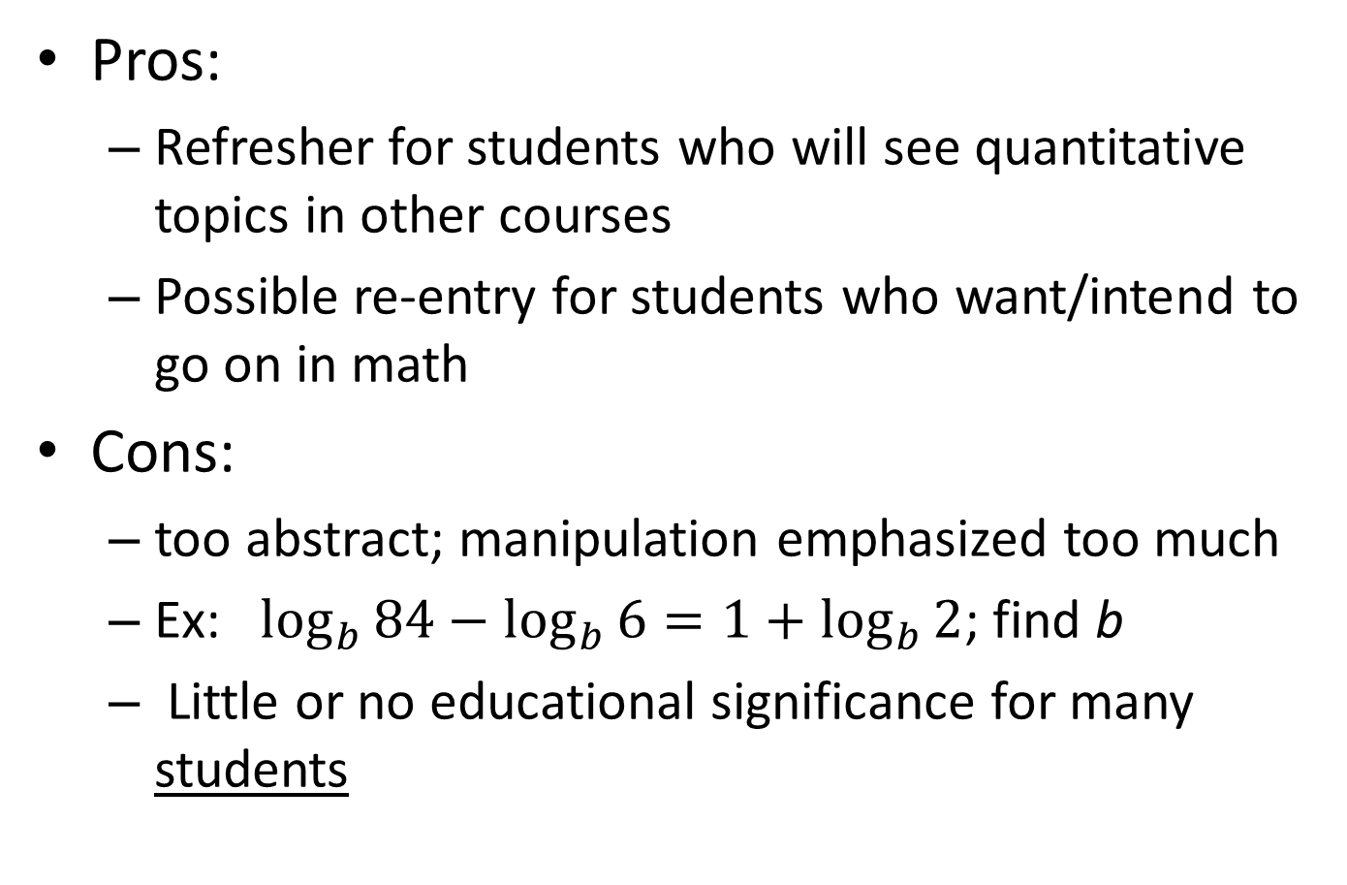
College Algebra
Pros:
  Refresher for students who will see quantitative topics in other courses
  Possible re-entry for students who want/intend to go on in math
Cons:
  too abstract; manipulation emphasized too much
  Ex: $\log_{b}{84}−\log_{b}{6}=1+\log_{b}{2}$; find b
  Little or no educational significance for many students

Slide 5
Liberal Arts Math
Pros:
  Novel topics for most students
  Broadening view of what math *IS*
  Significant aspects of aesthetics, psychology, creativity, etc
Cons:
  too eclectic
  May leave students with a distorted view of math
  Topics that mathies find sexy/cool/awesome/… can fail to land with many students
  Can be an educational deadend

Slide 6
Quantitative Literacy
Pros:
  Topics have obvious significance in everyday life
  Gen Ed goals RE informed participation in our culture/society
Cons:
  Unrealistic to think one course can empower/inspire students to use math tools in life
  Too eclectic
  How many people, even those highly math literate, actually use math as shown in QL class?
  Practitioners vs Consumers of math analyses

Slide 7
Synthesis
Standard courses have distinct goals:
  Polish up math skills for use in other disciplines
  Understand and appreciate the significance of mathematics as a tool, as a mode of analysis/thought, as a component of culture
  Equip students with a minimal command of math methods for informed participation in society
All worthy goals, but…
  Can’t do them all justice in one course
  Some may be infeasible for a single course
Hybridization: Combine selected aspects of all the above that work together

Slide 8
Course Goals
Focused immersive experience with mathematical modeling methodology
Demonstrate the power and utility of this methodology (similar to lib arts math)
Improve sophistication as a consumer of models based results (not as a practitioner of modeling) (similar to quantitive literacy.)
Expose students to a coherent mathematical development with significant depth
Brush up on math skills most likely to be encountered in quantitative aspects of courses outside mathematics (similar to college algebra)

Slide 9
(Some) Design Features
Evolution of successively more sophisticated growth models, based on plausible and natural hypothesized patterns of growth
Themes run through the entire course
  Developing and refining models
  Role and significance of assumptions
  Pattern identification, formalization, utilization
  Numerical, graphical, algebraic methods
  Discrete vs continuous models
  Role of parameters; qualitative dynamics
Emphasize conceptual understanding of how math models contribute to solving problems more than technical mastery of math skills for their own sakes

Slide 10
The Math Story

Slide 11
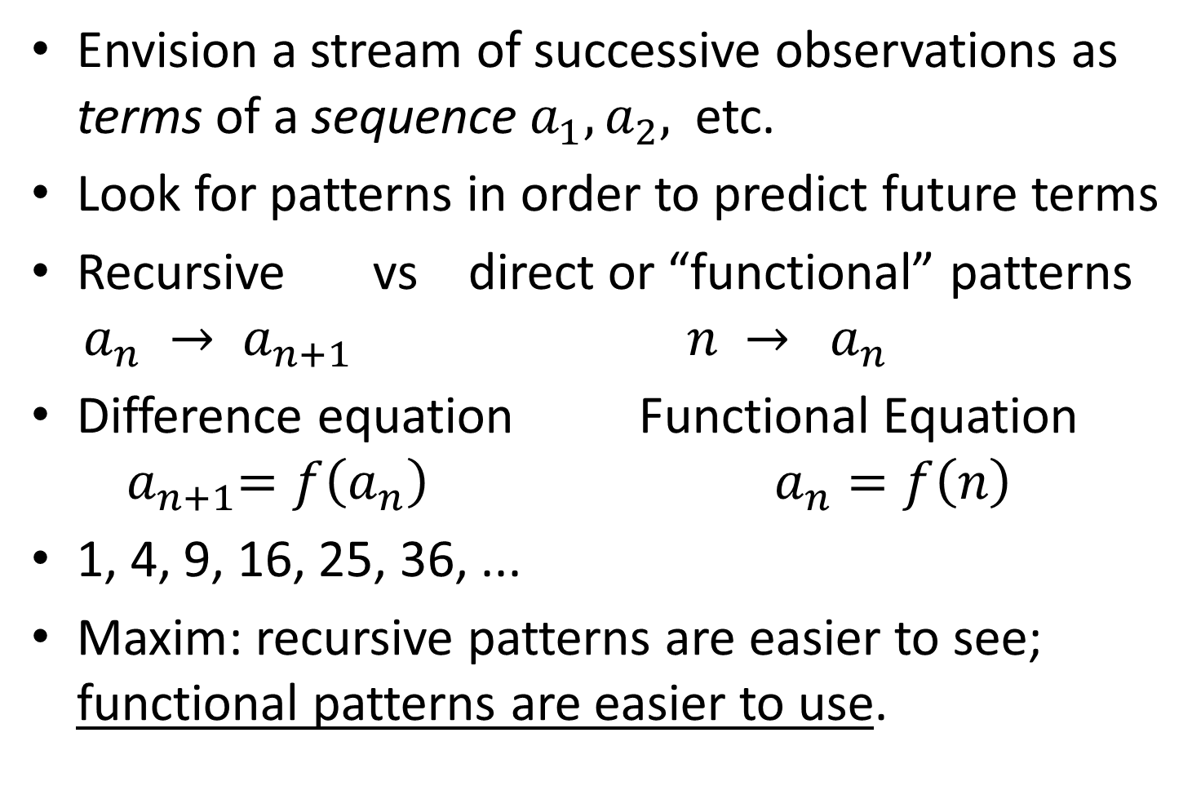
Discrete Models
Envision a stream of successive observations as terms of a sequence $a_{1}, a_{2},$ etc.
Look for patterns in order to predict future terms
Recursive vs direct or “functional” patterns
$a_{n} →{ a}_{n+1} n → a_{n}$
Difference equation Functional Equation
${ a}_{n+1}=f\left(a_{n}\right) a_{n}=f\left(n\right)$
1, 4, 9, 16, 25, 36, ...
Maxim: recursive patterns are easier to see; functional patterns are easier to use.

Slide 12
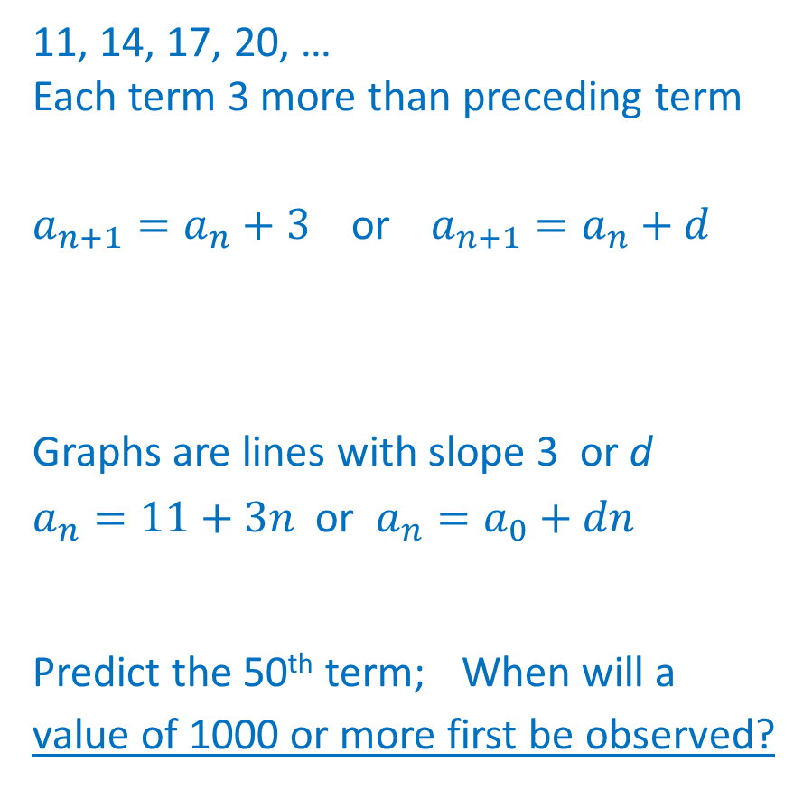
Model Development and Use
Observe or hypothesize a recursive pattern
.
Formulate difference equation
Study properties of corresponding family of models (eg. graphs, functional equation)
Answer questions about the model.
11, 14, 17, 20, …
Each term 3 more than preceding term
.
$a_{n+1}=a_{n}+3$ or $a_{n+1}=a_{n}+d$
Graphs are lines with slope 3 or d .
$a_{n}=11+3n$ or $a_{n}=a_{0}+dn$
Predict the 50th term;. When will a | value of 1000 or more first be observed?

Slide 13
Progression of Model Types
Arithmetic Growth; add a constant
Quadratic Growth; added amts grow arithmetically
Geometric Growth; multiply by a constant
Mixed Growth; add and multiply by constants
Logistic Growth; multiply by factor that depends linearly on current term
Refined Logistic Growth; divide by factor that depends linearly on current term
Linear Functions
Quadratic Functions
Exponential Functions
Exponential plus a constant
No closed form functional eqn
Standard Continuous Logistic Functions

Slide 14
Motivating The Progression
Arithmetic Growth needs no motivation
Plausible rationales. Eg. Geometric Growth
Structural Analysis. Eg. Mixed Models up next
Revision of earlier models. Eg. Logistic and Revised Logistic Models
Successive models steadily increase in complexity, sophistication
Continual appearance of important aspects of modeling: assumptions, parameters, fitting models to data; reconsidering assumptions …

Slide 15
Structural Analysis Example
Pollution level in a lake with clean water inflow
$p_{n}$ is a sequence of regularly spaced assays
Clean inflow leads to a proportional reduction
eg. $p_{n+1}= .9p_{n}$ (10% reduction per time step)
Plausible to assume pollution continues to be added to the lake at a constant rate.
Leads to a diff eq. such as$p_{n+1}= .9p_{n}+100$
Pattern analysis reveals:
$p_{n}={\left(.9\right)}^{n}p_{0}+100\frac{1−{\left(.9\right)}^{n}}{1−.9}$
Simplifies to $p_{n}={\left(.9\right)}^{n}{(p}_{0}−1000)+1000$

Slide 16
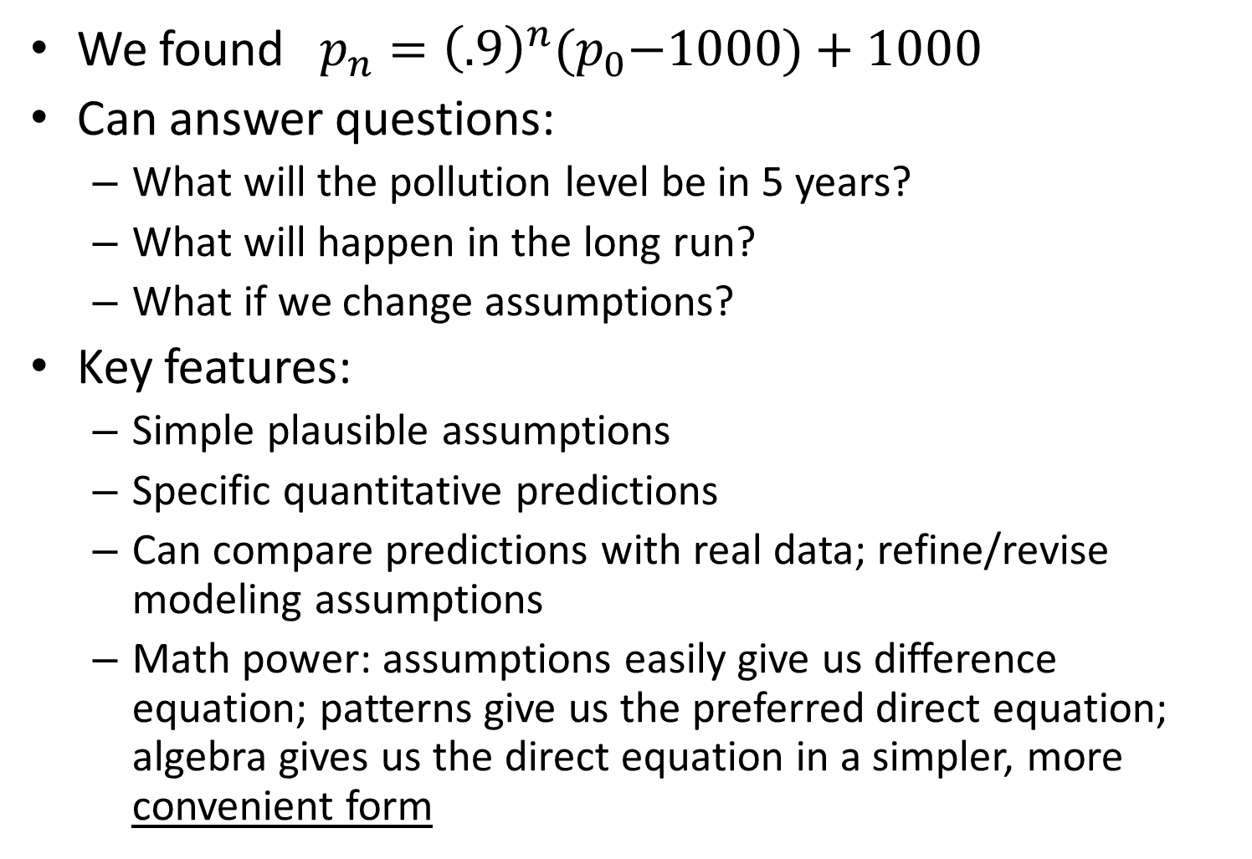
Example continued
We found $p_{n}={\left(.9\right)}^{n}{(p}_{0}−1000)+1000$
Can answer questions:
  What will the pollution level be in 5 years?
  What will happen in the long run?
  What if we change assumptions?
Key features:
  Simple plausible assumptions
  Specific quantitative predictions
  Can compare predictions with real data; refine/revise modeling assumptions
  Math power: assumptions easily give us difference equation; patterns give us the preferred direct equation; algebra gives us the direct equation in a simpler, more convenient form

Slide 17
Beautiful Evolution of Core Progression
Arithmetic growth obvious simple 1st guess
Geometric growth: strong biological rationale
Logistic growth: Exponential growth clearly unsustainable in long term. Revisit constant multiplier assumption.
Revised logistic growth: Logistic growth can exhibit chaotic behaviors and negative pop sizes. Revisit assumptions again.
Bonus: revised logistic growth leads to functional equations comprising an important family of functions.

Slide 18
Side Comment
Revised logistic growth referred to here is a little known bridge between traditional discrete and continuous treatments of logistic growth. See these references for more discussion:
Dan Kalman (2023) Improved Approaches to Discrete and Continuous Logistic Growth, PRIMUS, 33:2, 107-122, DOI: 10.1080/10511970.2022.2040664
Dan Kalman (2023) Verhulst Discrete Logistic Growth, Mathematics Magazine, 96:3, 244-258, DOI: 10.1080/0025570X.2023.2199676

Slide 19
Technology
Support experimentation with computational tools tailored to specific growth models
Suite of excel spreadsheets serving as apps
Also encourage use of graphing calculators – home screen iteration
Want to make hands-on exploration and pattern generation as easy as possible
Example: fitting a model to data by trial and error
Excel app demo/activity

Slide 20
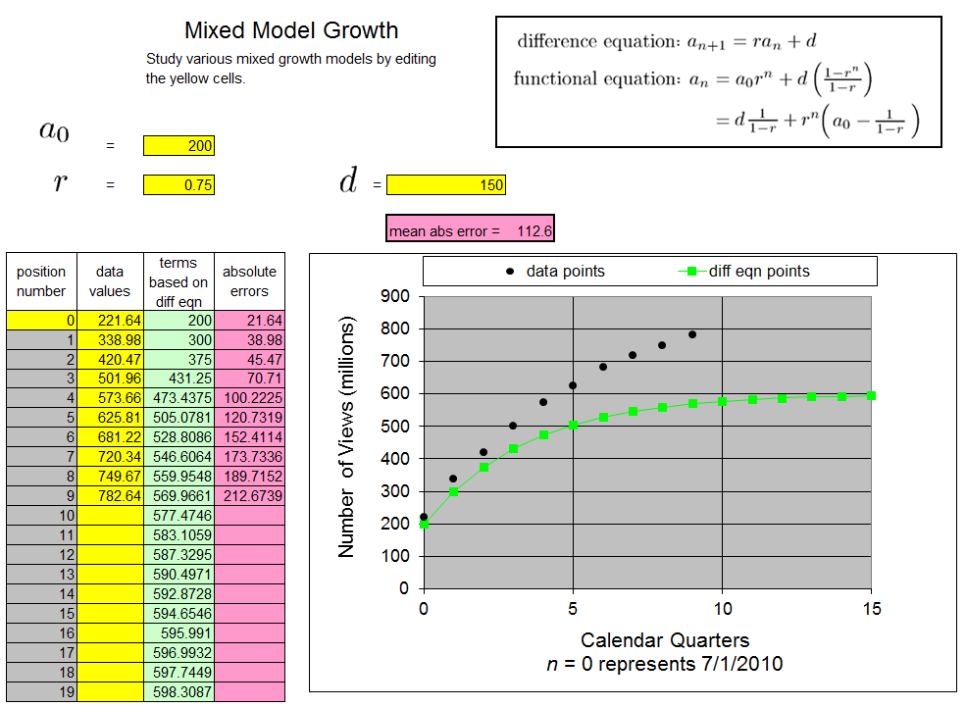

Slide 21
Interlude 1:
Fitting Model to Data
Activity
(Time Permitting)

Slide 22
SPOILER
ALERT
SPOILER
ALERT
The next slide reveals values of the parameters on the model fitting exercise that are close to optimal, producing a mean absolute error of 5.881. Do not look at it before you have a chance to find your own best fit.

Slide 23
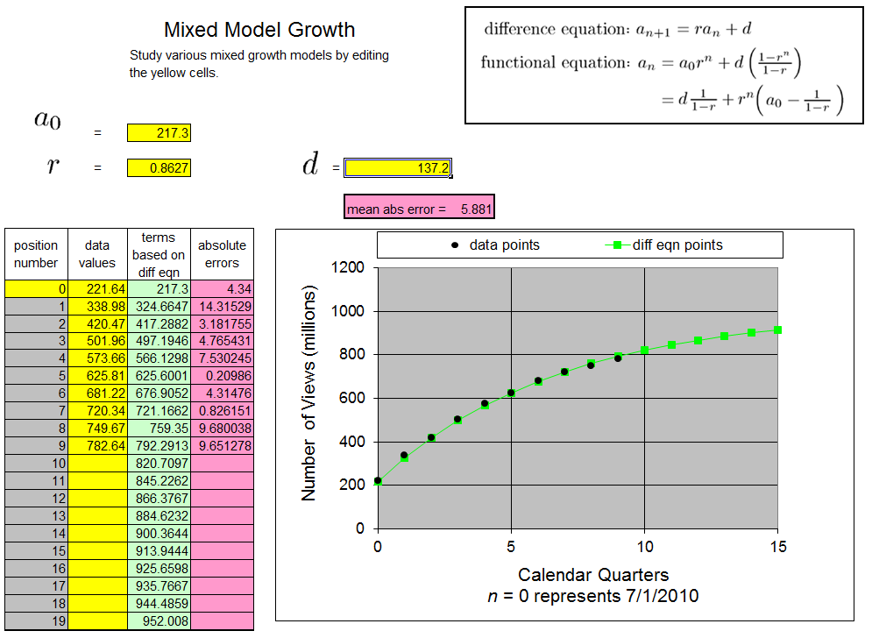

Slide 24
Pedagogy
Time to mention just a few pedagogical aspects
Repetition, Repetition, Repetition
Reading Comprehension, Math Skills & Techniques, Contextualized Problem Solving
Inductive patterns and functional equations (demonstration)
Clicker Questions

Slide 25
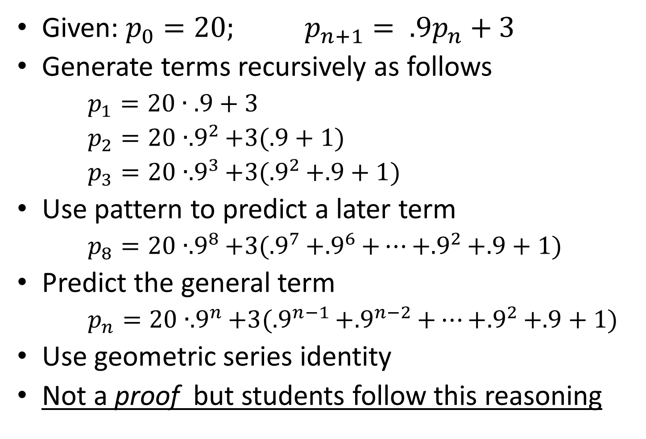
Pattern to Functional Equation Demo
Given: $p_{0}=20; p_{n+1}= .9p_{n}+3$
Generate terms recursively as follows
  $p_{1}=20∙.9+3$
  $p_{2}=20∙{.9}^{2}+3(.9+1)$
  $p_{3}=20∙{.9}^{3}+3({.9}^{2}+.9+1)$
Use pattern to predict a later term
  $p_{8}=20∙{.9}^{8}+3({.9}^{7}+{.9}^{6}+⋯+{.9}^{2}+.9+1)$
Predict the general term
  $p_{n}=20∙{.9}^{n}+3({.9}^{n−1}+{.9}^{n−2}+⋯+{.9}^{2}+.9+1)$
Use geometric series identity
Not a proof but students follow this reasoning

Slide 26
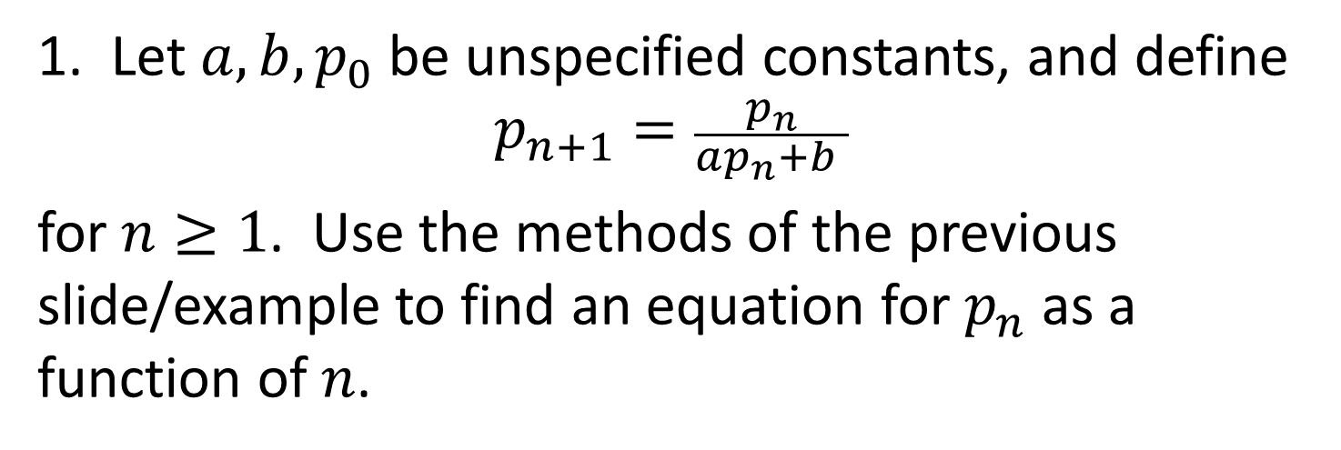
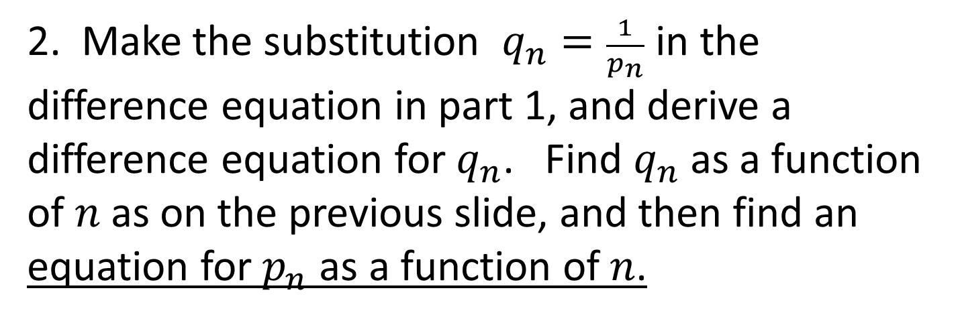
Homework Assignment
1. Let $a,b,p_{0}$ be unspecified constants, and define
$$p_{n+1}=\frac{p_{n}}{{ap}_{n}+b }$$
for $n≥1$. Use the methods of the previous slide/example to find an equation for $p_{n}$ as a function of $n$.
2. Make the substitution $q_{n}=\frac{1}{p_{n}}$ in the difference equation in part 1, and derive a difference equation for $q_{n}$. Find $q_{n}$ as a function of $n$ as on the previous slide, and then find an equation for $p_{n}$ as a function of $n$.

Slide 27
Interlude 2:
Clicker Questions
(Time Permitting)

Slide 28
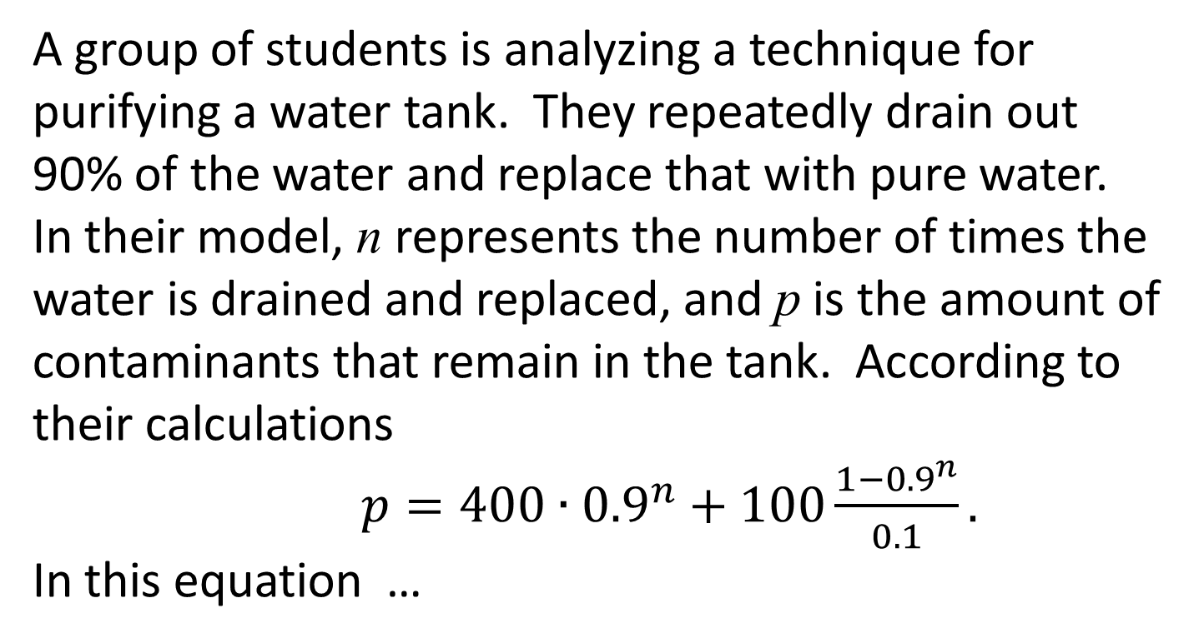
A group of students is analyzing a technique for purifying a water tank. They repeatedly drain out 90% of the water and replace that with pure water. In their model, n represents the number of times the water is drained and replaced, and p is the amount of contaminants that remain in the tank. According to their calculations
$p=400∙{0.9}^{n}+100\frac{1−{0.9}^{n}}{0.1}.$
In this equation …
… p is expressed as a function of n
… n is expressed as a function of p
… neither variable is expressed as a function of the other

Slide 29
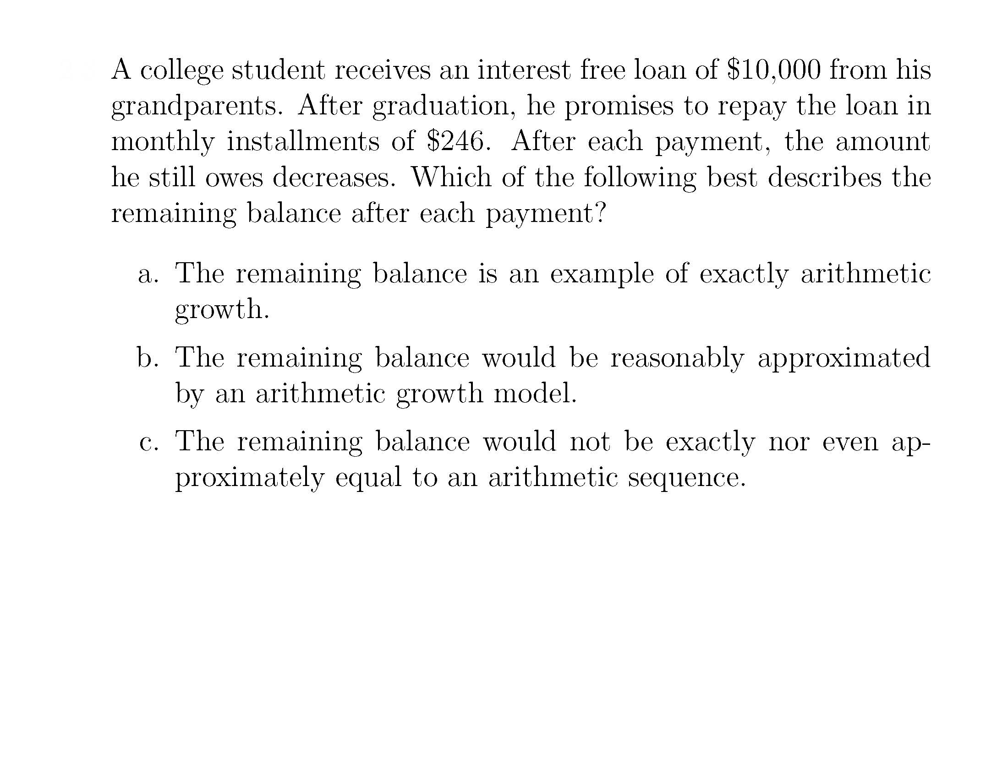
S4

Slide 30
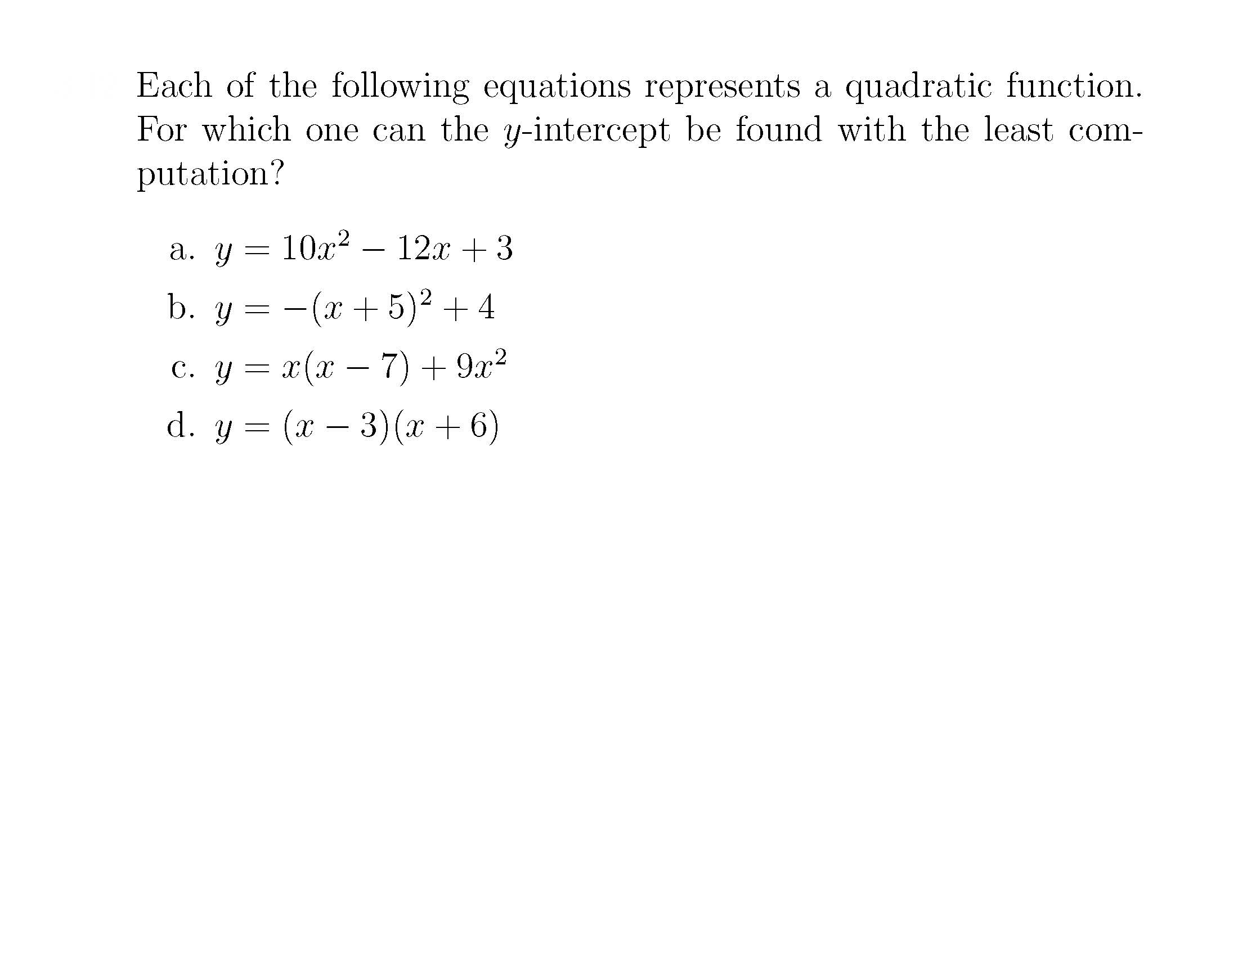
S5

Slide 31
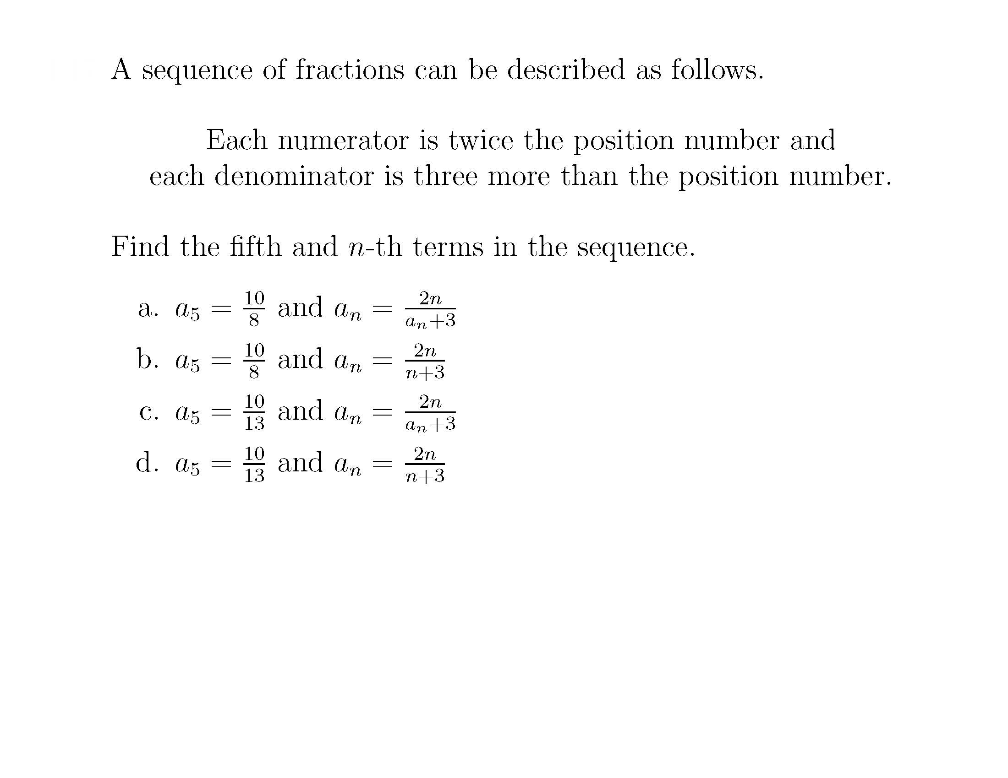
S6

Slide 32
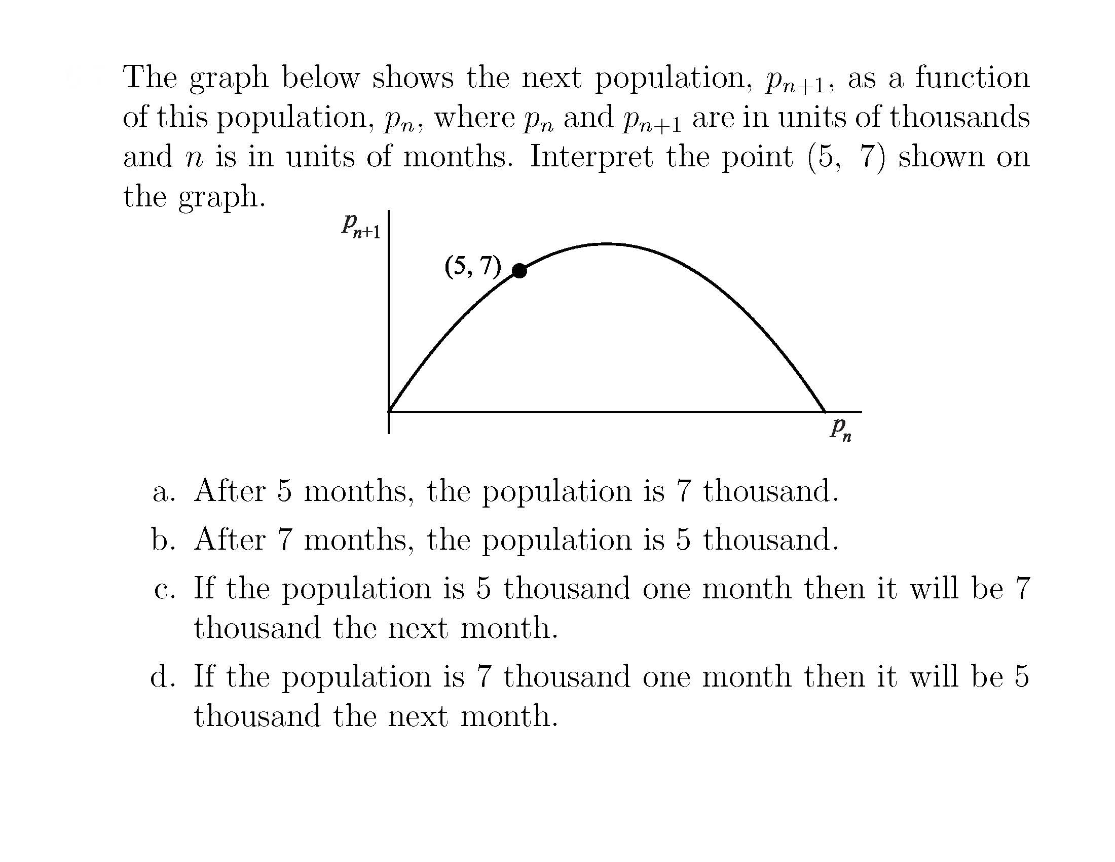
S7

Slide 33
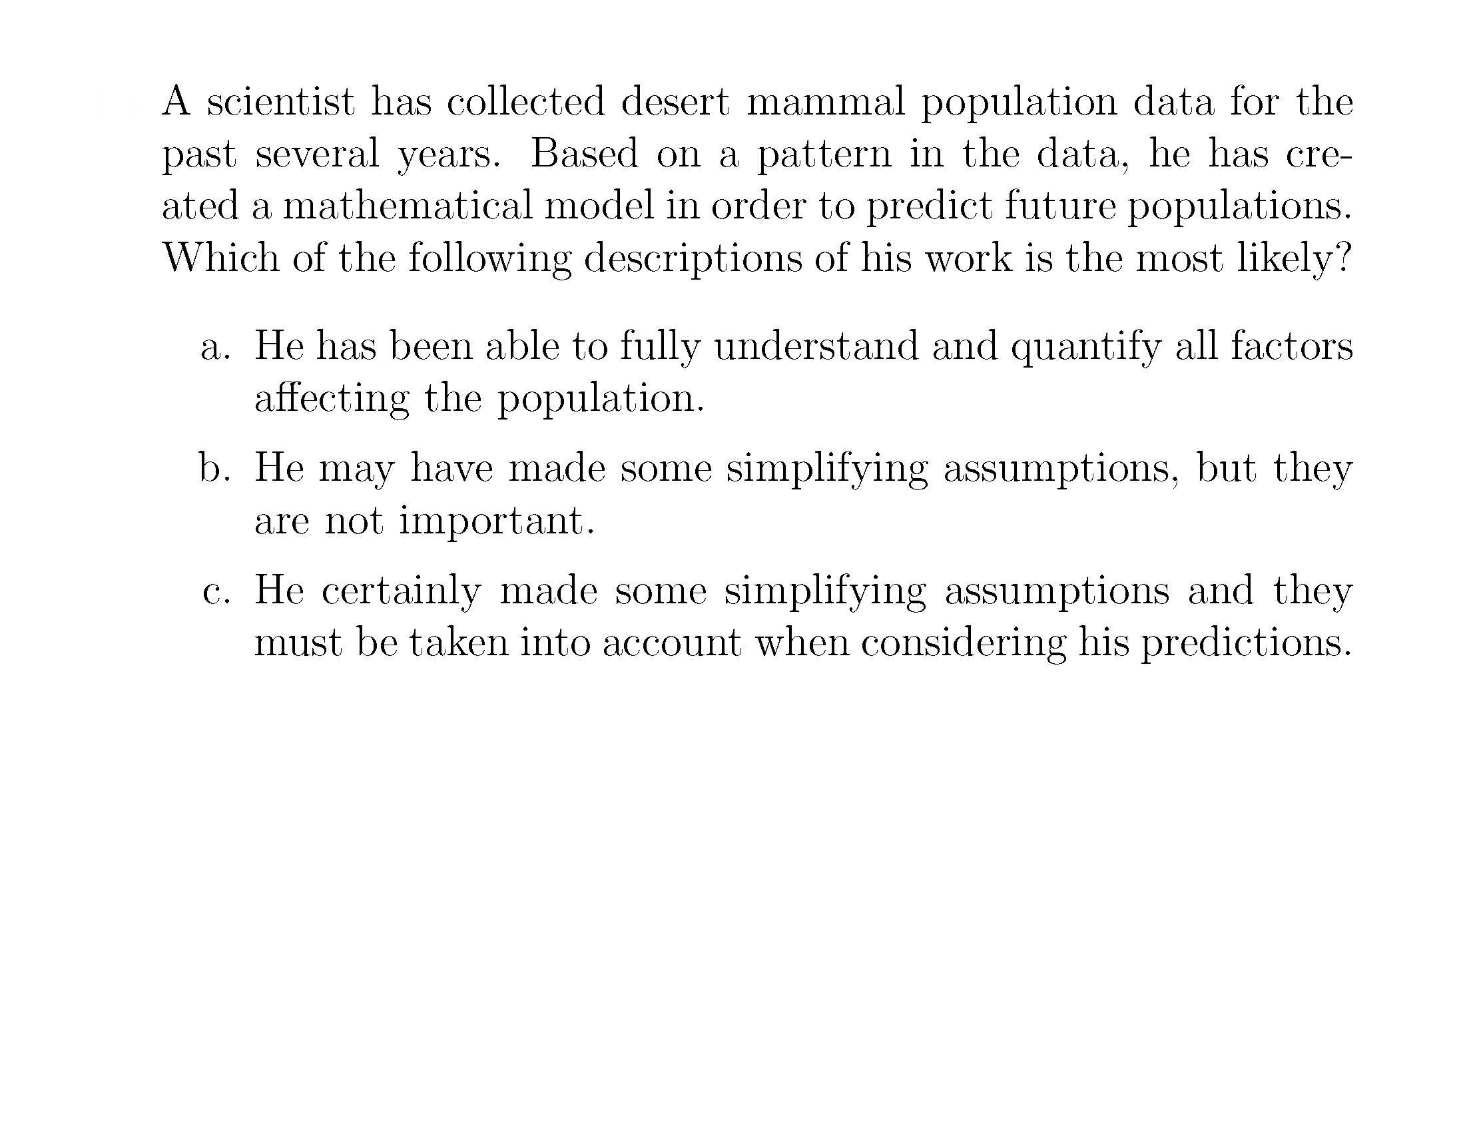
S8

Slide 34
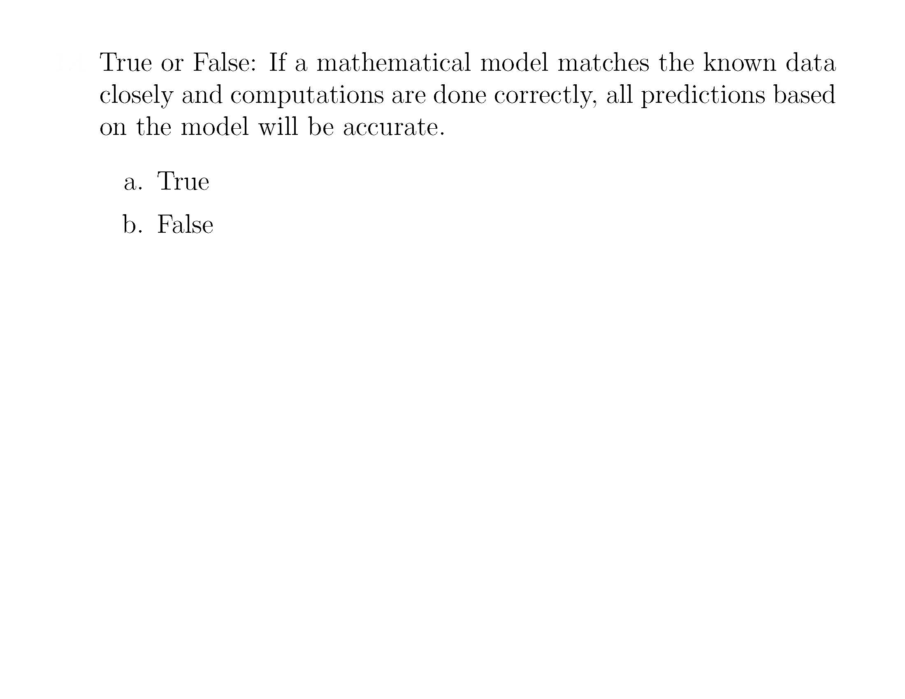
S10

Slide 35
Classroom Experience
Strong buy-in from students
Those with strongest math prep sometimes object to intellectual demands
Many positive comments such as
  I am usually awful at math but I really understood this course
  First time I actually enjoyed a math course
  I was dreading math but this turned out to be one of my favorite courses.
Feasible to cover the entire story (thru revised logistic growth) in 14 week 3 cr. course, but very rushed – no time for term projects

Slide 36
Wrap Up
There is a lot more to say about this curriculum, though possibly not as much more as I have said in print (to paraphrase Paul Halmos).
Links to references are on the webpage, and included on the next slide for future reference.
Thanks for participating.

Slide 37
References
Essays about the EMM curriculum Concept
“Elementary Math Models: College Algebra Topics and a Liberal Arts Approach,” Chapter 32 in Nancy Baxter Hastings et al, eds, A Fresh Start for Collegiate Mathematics: Rethinking the Courses below Calculus, MAA, Washington DC, 2006, pp 304-309. (See page 304)
(https://maa.org/sites/default/files/pdf/pubs/books/members/NTE69.pdf)
Entry Level College Mathematics: Algebra or Modeling:
  AMATYC Review Article Spring 2003 (http://emm2e.info/workshopSE/amatycemm.pdf)
  Slides based on the article (http://emm2e.info/workshopSE/models & algebra slides.pdf)
  Preface to EMM text (http://emm2e.info/workshopSE/preface from ams page.pdf)
Papers about Refined Logistic Growth
(accessible to MAA members by logging in at MAA.org)
Improved Approaches to Discrete and Continuous Logistic Growth, PRIMUS, 33:2, 107-122, 2023.
(https://www.tandfonline.com/doi/full/10.1080/10511970.2022.2040664)
Verhulst Discrete Logistic Growth, Mathematics Magazine, 96:3, 244-258, 2023.
(https://www.tandfonline.com/doi/full/10.1080/0025570X.2023.2199676)

